Slide 1
Wearable Device Service Extension
Shufan Xing, Wen Zhang
Team: Forward

Slide 2
Introduction
DynamoDB
AWS NoSQL data store
Asynchronous Application Design
Asynchronous invocation and InvocationCallback Interface in JAX_RS
(optional) Elasticsearch & Kibana
Search and analyze metrics data in real time and create dashboard for Wearable Device web service

Slide 3
Asynchronous Application Design
Hypothesis: Asynchronous request improves client performance
Tasks:
1: client side:
JAX-RS Asynchronous requests
Asynchronous invocation and InvocationCallback Interface
each Asynchronous request writes data individually into output file.
2: server side: no need to use Async
DB
server
POST/GET
client
File
Thread 1
Callback
POST/GET
Thread 2
Callback
Notes:
Hypothesis: Asynchronous request improves client performance
Tasks:
1: client side: change to send JAX-RS Asynchronous requests. I'm planning to use Asynchronous invocation and InvocationCallback Interface. Implement InvocationCallback Interface to make each Asynchronous request writes data individually into output file.
2: server side: no need to use async since the JAX-RS would spawn a new worker thread for each client request (already in parallel), and the client would always need to wait for the sever/database to reply the expected data.

Slide 4
Tests to perform
1: run 32, 64, 128, and 256 threads and compare their result with sync results.
2: check the bottleneck
3: scale up client threads and number of iterations
Notes:
1: run the 32, 64, 128, and 256 threads the same as previous assignments and compare its result with sync results.
2: check the bottleneck, previously it was on client side (local machine, I start to get timeout exceptions when running 512 threads), now I'm expecting the bottleneck move to server side or database side (CPU or memory utilization grow higher), and thus I will scale up the instances accordingly.
3: after scale up the instances, scale up my client threads and number of iterations to see how much higher client loads I can get by using async. Run 512 and 1024 threads as well as 256 and 512 iterations or even higher.

Slide 5
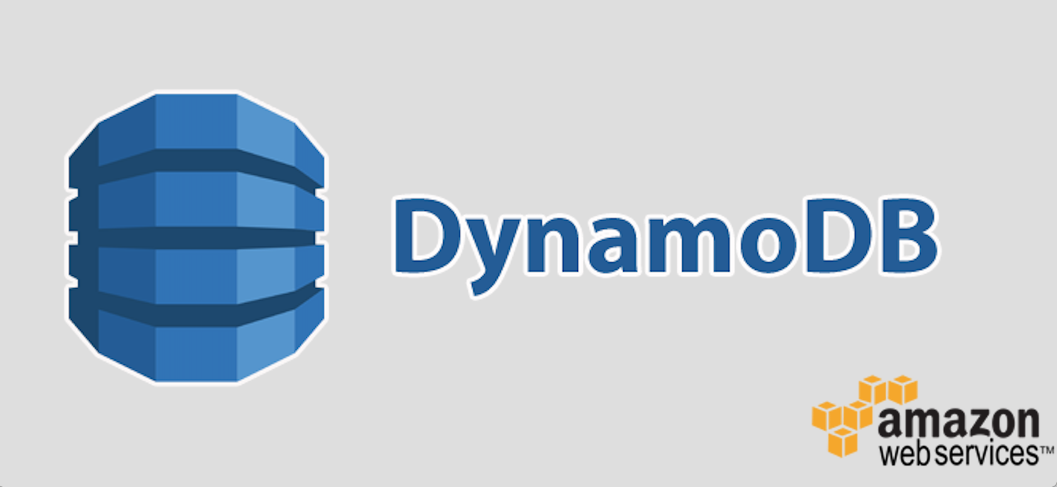
DynamoDB
Why DynamoDB:
NoSQL (not only SQL)
AWS key-value store
Optimized in I/O
Scalable
Fit for simple queries
Basic Design
Dynamic schema in DynamoDB
Hash key: UserID
Range key: “day” + “hour”
Notes:
--There are many types of NoSQL databases, including columnar (Cassandra, HBase), key-value store(DynamoDB, Riak), document-store (MongoDB, CouchDB), and graph (Neo4j, OrientDB) categories.
--DynamoDB a highly available, scalable, and distributed data store
-- scalable read-write I/O running on IOPS-optimized solid state drives. It deliver highly predictable performance.
-- DynamoDB spreads the data across partitions and raises throughput. As a contrary, Relational Databases are scaled by increasing the power of the hardware.
-- SQL databases are good fit for the complex query intensive environment. In Wearable Service, the queries are simple enough to use DynamoDB instead.
SQL databases have predefined schema whereas NoSQL databases have dynamic schema for unstructured data. Only Hash Type Primary Key or Hash and Range Type Primary Key is mandatory in a DynamoDB table.
In our case, we can use Hash and Range Type Primary Key to uniquely identifies an item.
Use UserID as Hash key for data partition.
Use the combination of the values of “day” and “hour” as range key to provide time range queries.

Slide 6




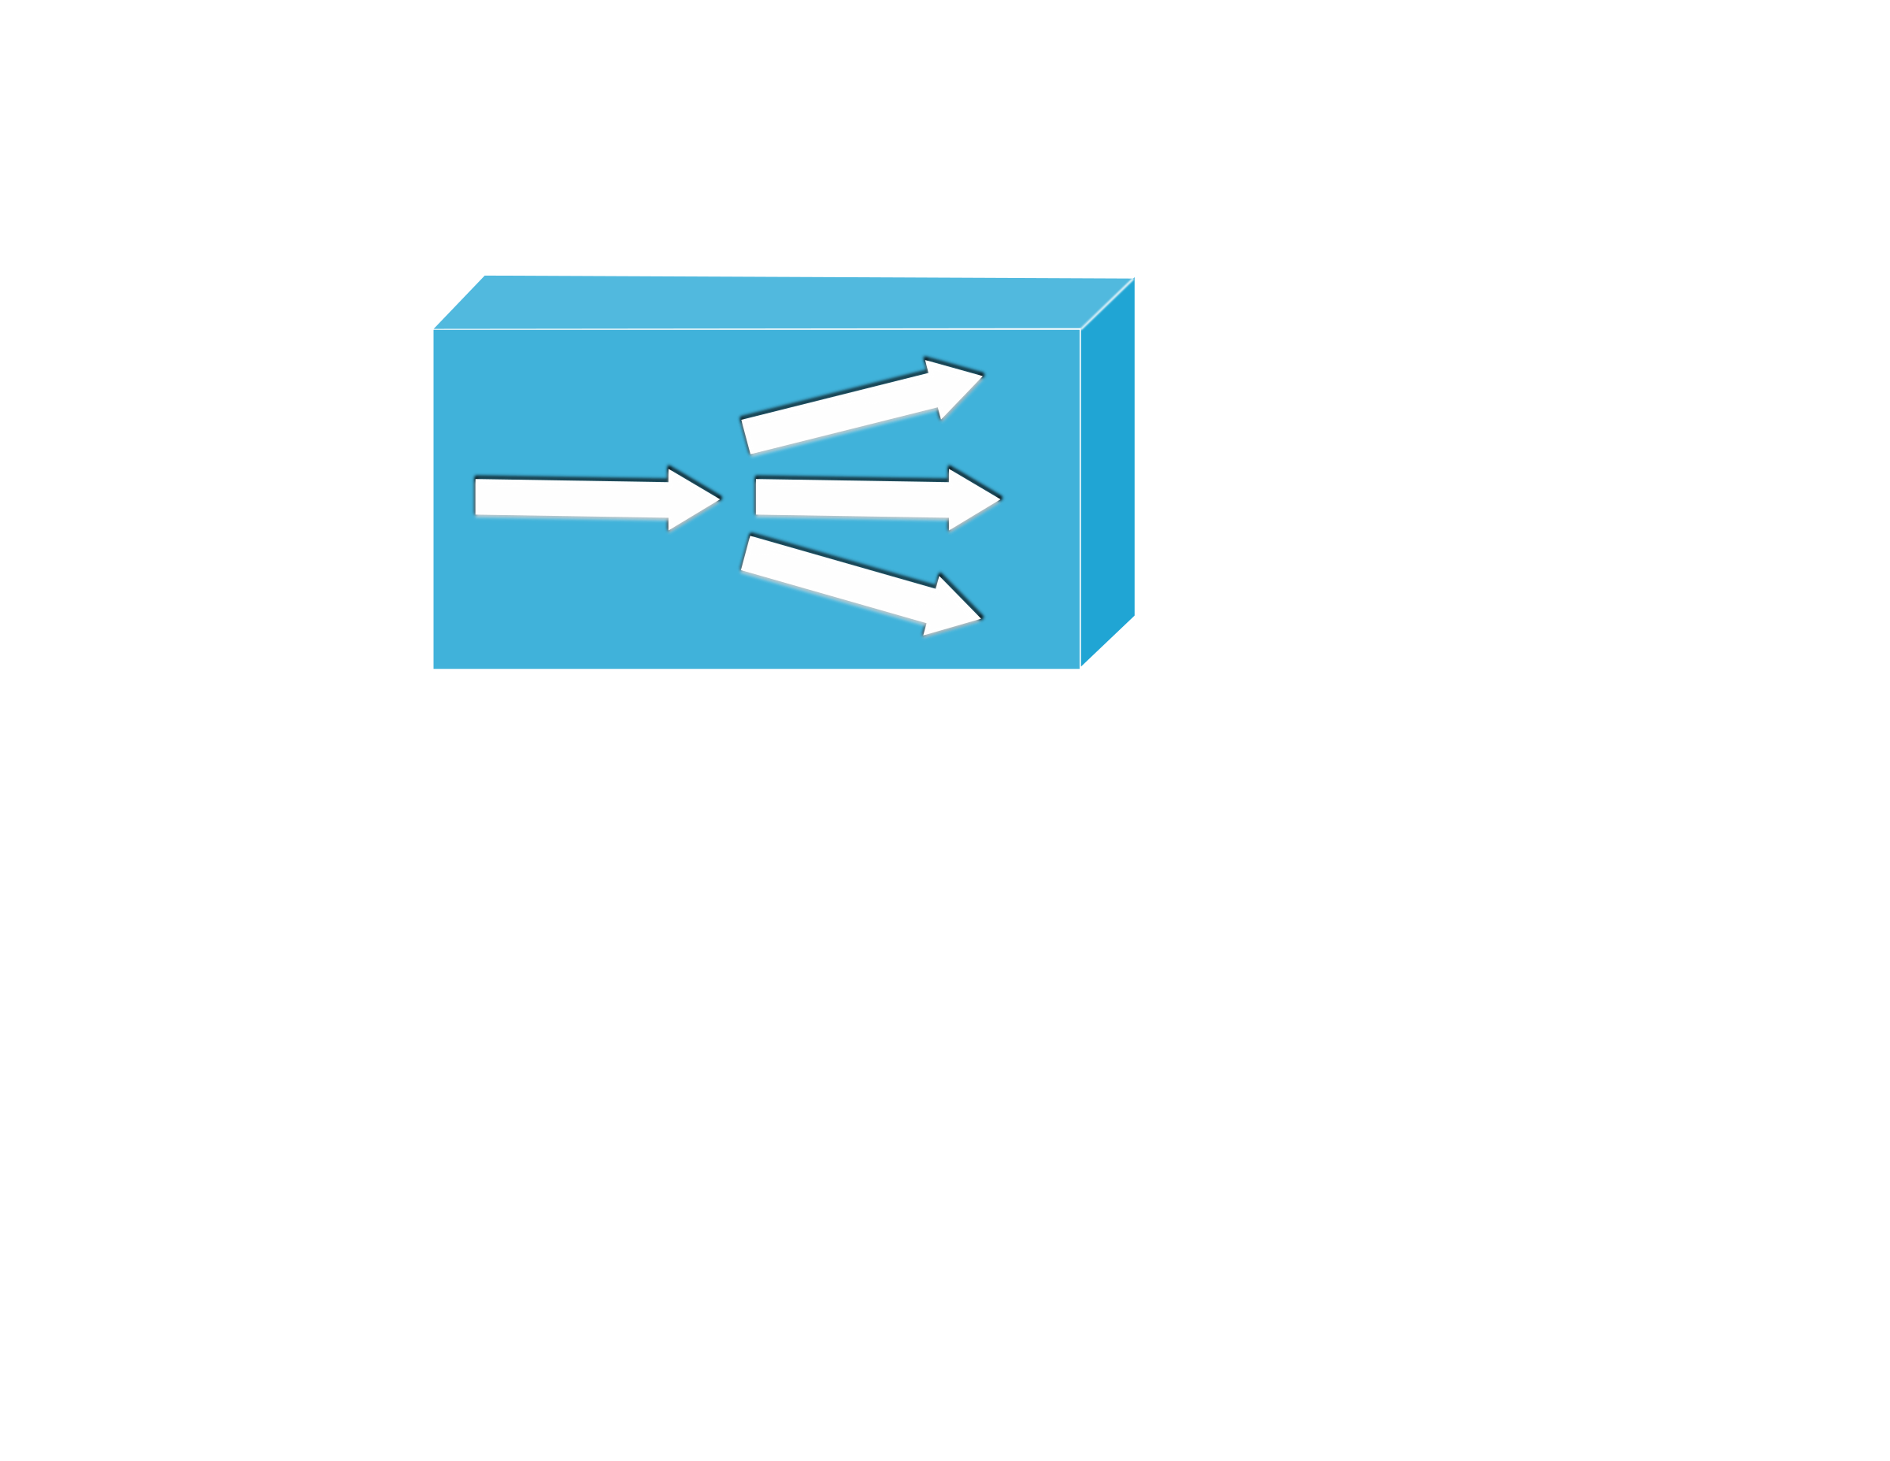



System Architecture
clients
LB
DynamoDB
servers
Elasticsearch
Kibana
Notes:
Currently, we keep query response times in a file, and all other statistical data, such as latency and throughput in memory. We need external application to get statistic results and visualizations.
In real web service, what if I need to need to know how many queries in last hour? How many failures caused by database queries? What happened before my server crash down? What should I do if my EC2 instance stopped and I lost the local log file? We need a stable and reliable log service to keep our log data.
Elasticsearch and Kibana provide open-source solutions for log services.

Slide 8

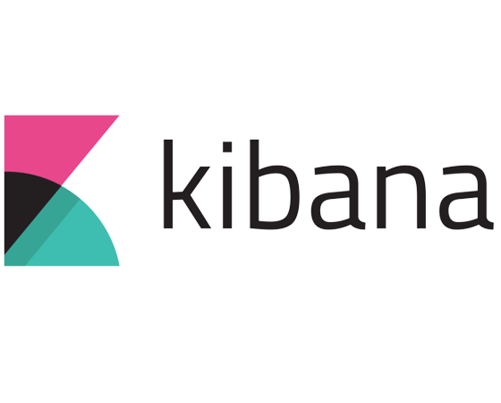
Elasticsearch & Kibana
Why?
Currently, we keep statistical data in files and memory.
In web service, we need log service.
Notes:
Currently, we keep query response times in a file, and all other statistical data, such as latency and throughput in memory. We need external application to get statistic results and visualizations.
In real web service, what if I need to need to know how many queries in last hour? How many failures caused by database queries? What happened before my server crash down? What should I do if my EC2 instance stopped and I lost the local log file? We need a stable and reliable log service to keep our log data.
Elasticsearch and Kibana provide open-source solutions for log services.

Slide 9
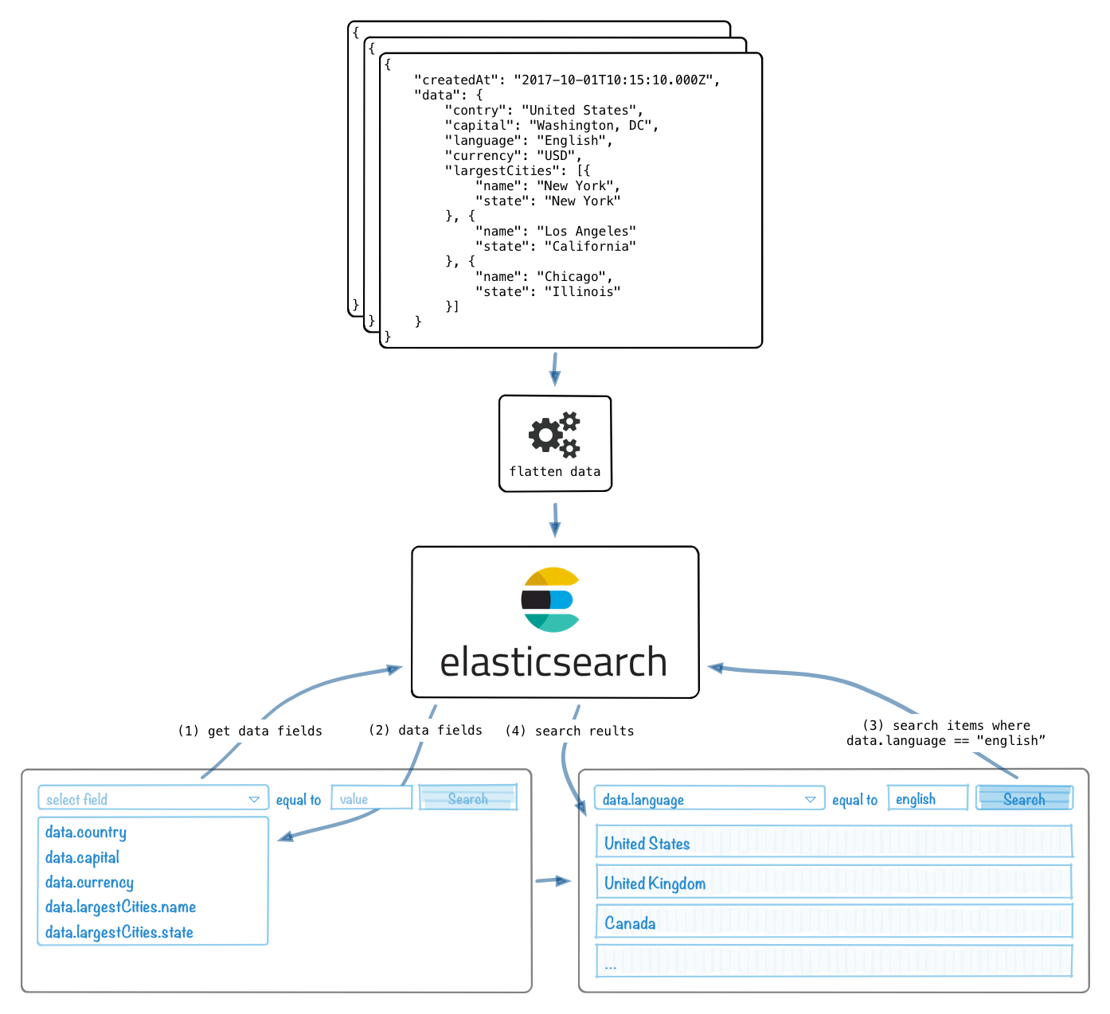
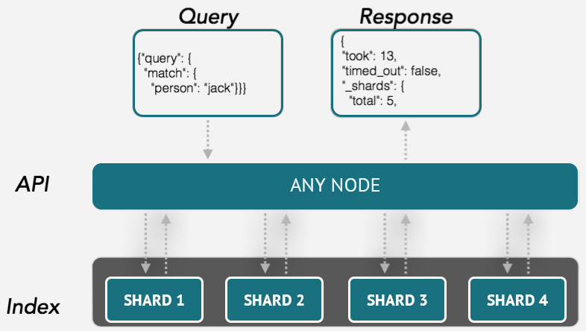
Elasticsearch
Elasticsearch is a hosted distributed system to store, search, and analyze big volumes of data quickly and in near real time.
It provides different search ways, such as by simple basic searches or by complex SQL-like queries.
Notes:
For example, Elasticsearch may accept and store our response time and latency data as JSON data.
By these features, we may get statistical results such as mean latency, throughput, and so on.

Slide 10
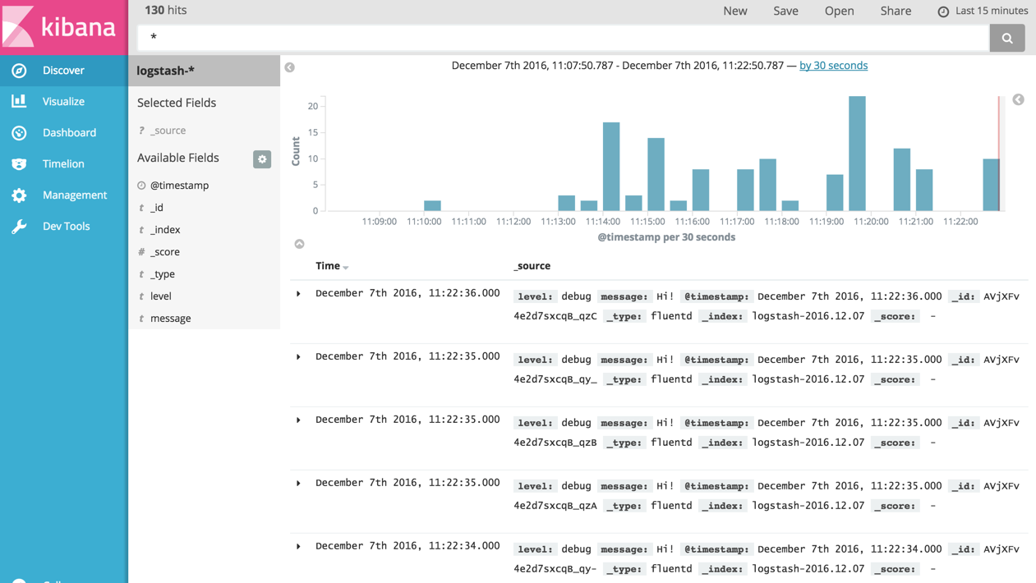
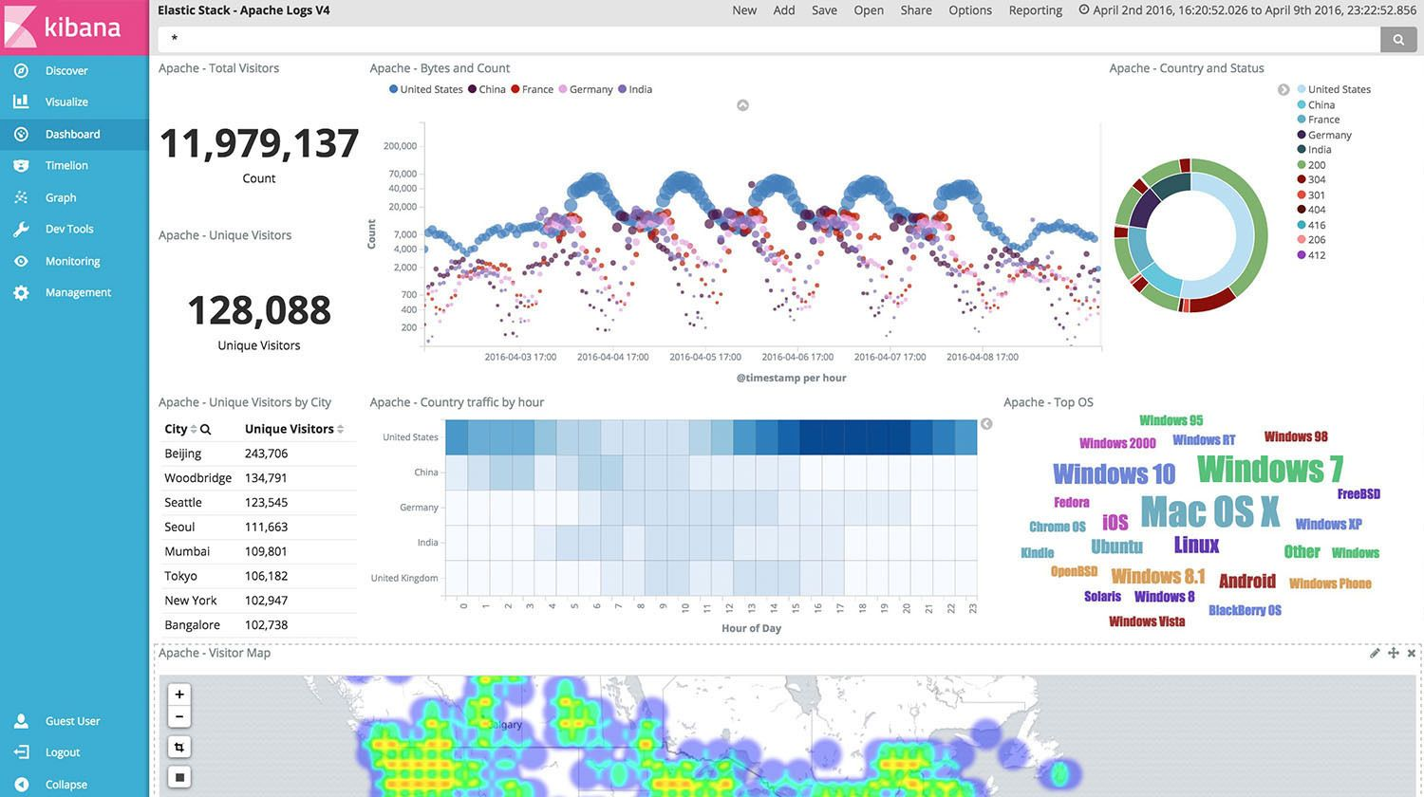
Kibana
Real-time log data
Visualization dashboard
Notes:
Kibana is an open source analytics and visualization platform designed to work with Elasticsearch.
In Discover Tab, we can monitor real-time incoming logs or history data. For example in last 15 minutes or 2 hours, or the data in last month, etc.
We can easily build our own visualizations and dashboard, such as Line, Pie, Vertical bar, table, maps, timelines, and so on.

